Slide 1
GIS 2019 Group Project
SFO
Your team

Slide 2
Introduction
Introduce your self/team
Introduce your project

Slide 3
Argument: What is Your Project About?
Give the context of your project
What was the motivation?

Slide 4
Evidence: How Did You Support Your Argument?
What data did you select for your project?
Remember to reference your data source

Slide 5
Methodology: Briefly Describe How You Developed Your Output
Mention the program you used to code
Mention the features of the computer program you used: libraries, which libraries were deployed for your project
Briefly describe what these libraries are about
For example:
pandas helped you read in your data which was in spreadsheet format.
pandas also lets you set up your data in a dataframe
possibly explain what a data frame is

Slide 6
Provide a sample of your code
import pandas as pd from plotly.offline import plot import plotly.graph_objs as go
#We read the data into a variable df = pd.read_excel("GISdata.xlsx", sheet_name = "womenOccupation")
#We use the Bar function of the go library womenoccupation = go.Bar(x= df["occupation"], y=df["women"], #We add color to the graph using the jet scale marker = {"color": df["women"], "colorscale" : "Jet"} ) #We use the Layout function of the go library titles = go.Layout( #Define title of the graph title = "Percentage of Women Employed by Occupation", #Define title for x-axis xaxis=go.layout.XAxis( title=go.layout.xaxis.Title( text="Occupation", ) ), #Define title for y-axis yaxis=go.layout.YAxis( title=go.layout.yaxis.Title( text="Percentage", )

Slide 7
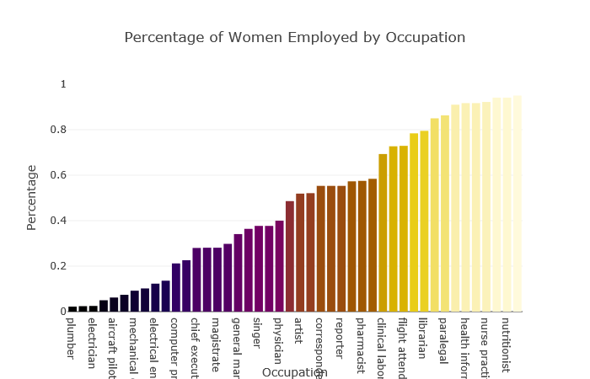
Present Your Output

Slide 8
Conclusion: Interpret the Output
Present your observations from the graph
What inferences can you make?

